Slide 1
Chapter 2
Data Science Process

Slide 2
Data
a "given" or a fact that represents something in real world
raw materials, can be processed, structured or unstructured
Data are elements of analysis
Information
Data that have meaning in context
Data related
Data after manipulation
Knowledge
In data science, knowledge refers to meaningful insights or patterns derived from data through analysis, modeling, and interpretation.
Acquired through experience or learning
It is a concept mainly for humans unlike data and information.
Knowledge is not information and information is not data.
Knowledge is derived from information in the same way information is derived from data.

Slide 3
Example
Data – Raw, unprocessed facts (e.g., "500 movie reviews").
Information – Processed or structured data (e.g., "300 positive and 200 negative movie reviews").
Knowledge – Actionable insights extracted from the information (e.g., "Reviews mentioning 'amazing' and 'great' tend to be positive").
Wisdom – Applying knowledge effectively for decision-making (e.g., "A recommendation system suggests movies based on positive reviews").
Notes:
https://www.quora.com/Can-someone-give-a-simple-example-for-data-information-knowledge-and-wisdom

Slide 4
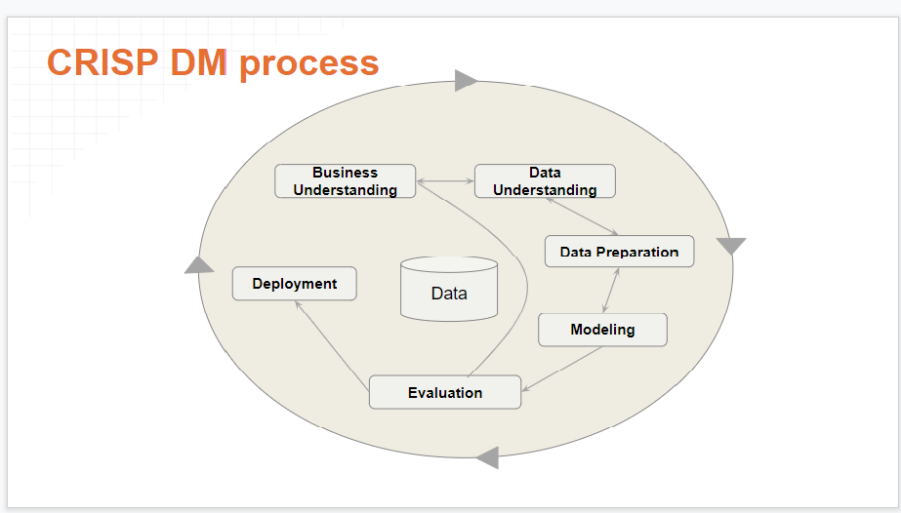
CRISP Data Mining Framework

Slide 5
CRISP Data Mining Framework
The CRoss Industry Standard Process for Data Mining (CRISP-DM) is a process model that serves as the base for a data science process. It has six sequential phases:
Business understanding – What does the business need?
Data understanding – What data do we have / need? Is it clean?
Data preparation – How do we organize the data for modeling?
Modeling – What modeling techniques should we apply?
Evaluation – Which model best meets the business objectives?
Deployment – How do stakeholders access the results?

Slide 6
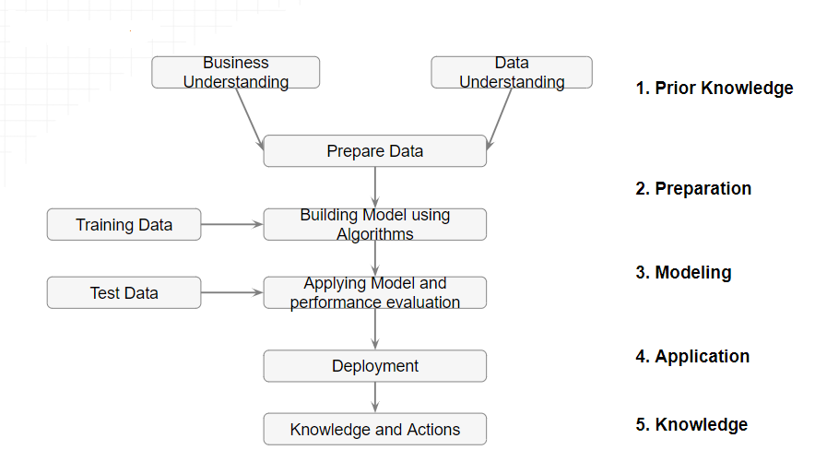
Data Science Process

Slide 7
Prior Knowledge
Gaining information on:
Objective of the problem
Subject area of the problem
Data

Slide 8
Objective of the problem
The data science process starts with a need for analysis, a question, or a business objective. This is possibly the most important step in the data science Process. Without a well-defined statement of the problem, it is impossible to come up with the right dataset and pick the right data science algorithm.
Example : The business objective of this hypothetical case is: If the interest rate of past borrowers with a range of credit scores is known, can the interest rate for a new borrower be predicted?

Slide 9
Subject area of the problem
The process of data science uncovers hidden patterns in the dataset by exposing relationships between attributes. But the problem is that it uncovers a lot of patterns. The false or spurious signals are a major problem in the data science process. It is up to the practitioner to sift through the exposed patterns and accept the ones that are valid and relevant to the answer to the objective question. Hence, it is essential to know the subject matter, the context, and the business process generating the data.
Example: The lending business is one of the oldest, most prevalent, and complex of al the businesses. If the objective is to predict the lending interest rate, then it is important to know how the lending business works,

Slide 10
Data
Understanding how the data is collected, stored, transformed, reported, and used is essential to the data science process. There are quite a range of factors to consider: quality of the data, quantity of data. The objective of this step is to come up with a dataset to answer the business question through the data science process. For the following example, a sample dataset of ten data points with three attributes has been put together: identifier, credit score, and interest rate.

Slide 11
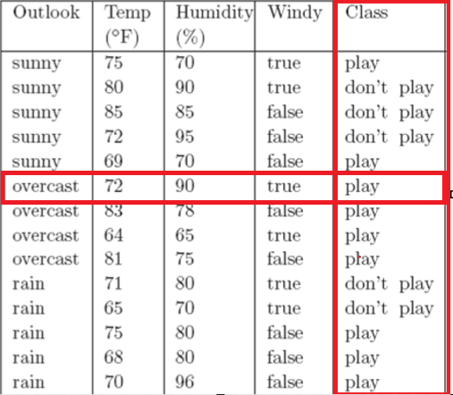
Data Types
Two types of data: Labelled Data & Unlabelled Data
Labelled data
Specially designated attribute and the aim is to use the data given to predict the value of that attribute for instances that have not yet been seen. Data of this kind is called labelled.
Outlook=sunny | Temp=79 | Humidity=88 | Windy=false | Class=?

Slide 12
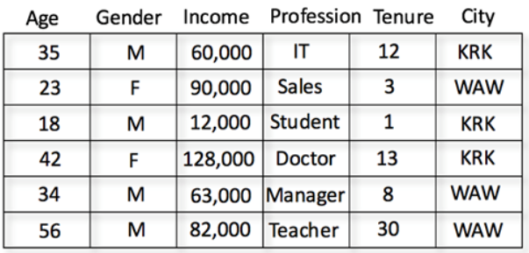
Data Types
Unlabelled data
Data that does not have any specially designated attribute is called unlabelled.
Here the aim is simply to extract the most information we can from the data available.

Slide 13
Learning Methods
Supervised Learning
Data mining using labelled data is known as supervised learning.
Classification
If the designated attribute is categorical, the task is called classification.
Classification is one form of prediction, where the value to be predicted is a label.
a hospital may want to classify medical patients into those who are at high, medium or low risk
we may wish to classify a student project as distinction, merit, pass or fail
Nearest Neighbour Matching, Classification Rules, Classification Tree, …

Slide 14
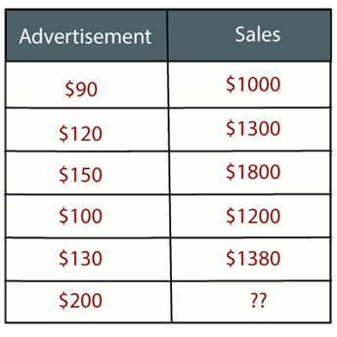
Learning Methods
Numerical Prediction (Regression)
If the designated attribute is numerical, the task is called numerical prediction (regression).
Numerical prediction (often called regression) is another. In this case we wish to predict a numerical value, such as a company’s profits or a share price.
A very popular way of doing this is to use a Neural Network
Example: Suppose there is a marketing company A, who does various advertisement every year and get sales on that. The list (right-side) shows the advertisement made by the company in the last 5 years and the corresponding sales. Now, the company wants to do the advertisement of $200 in the year 2019 and wants to know the prediction about the sales for this year.

Slide 15
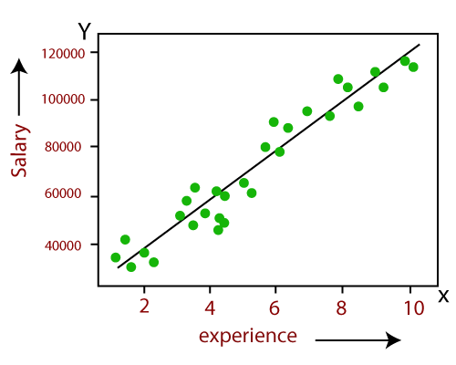
Learning Methods
Regression (Numerical Prediction)
Notes:
https://www.javatpoint.com/regression-analysis-in-machine-learning

Slide 16
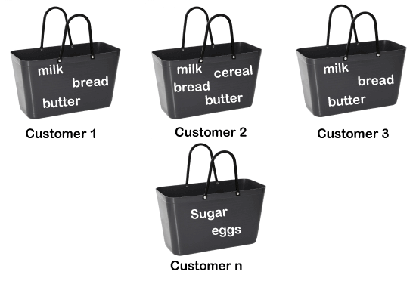
Learning Methods
Unsupervised Learning
Data mining using unlabelled data is known as unsupervised learning.
Association Rules
Sometimes we wish to use a training set to find any relationship that exists amongst the values of variables, generally in the form of rules known as association rules.
APRIORI
Market Basket Analysis
Example, if a customer buys bread, he most likely can also buy butter, eggs, or milk, so these products are stored within a shelf or mostly nearby.
Possible associations include:
if customers purchase milk they also purchase bread {milk} → {bread}
if customers purchase milk and eggs they also purchase butter and bread {milk, eggs} → { butter, bread}

Slide 17
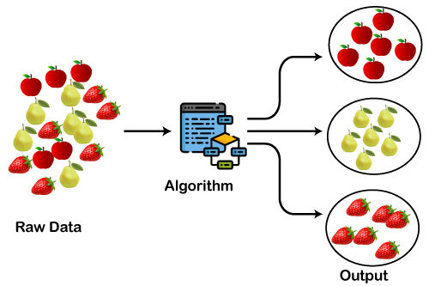
Learning Methods
Clustering
Clustering algorithms examine data to find groups of items that are similar.
K-Means Clustering, Agglomerative Hierarchical Clustering
Notes:
https://www.javatpoint.com/clustering-in-machine-learning

Slide 18
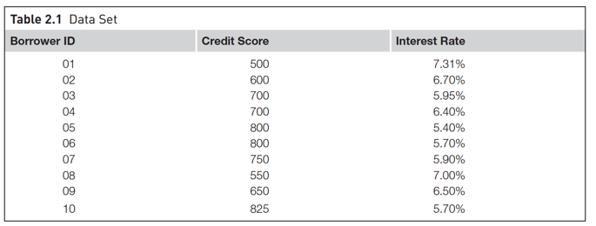
A dataset (example set) is a collection of data with a defined structure. Table 2.1 shows a dataset. It has a well-defined structure with 10 rows and 3 columns along with the column headers. This structure is also sometimes referred to as a “data frame”.
A data point (record, object or example) is a single instance in the dataset. Each row in Table 2.1 is a data point. Each instance contains the same structure as the dataset.
An attribute (feature, input, dimension, variable, or predictor) is a single property of the dataset. Each column in Table 2.1 is an attribute. Attributes can be numeric, categorical, date-time, text, or Boolean data types. In this example, both the credit score and the interest rate are numeric attributes.

Slide 19
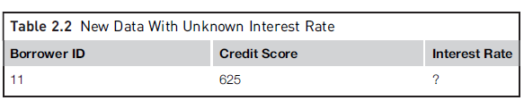
A label (class label, output, prediction, target, or response) is the special attribute to be predicted based on all the input attributes. In Table 2.1, the interest rate is the output variable.

Slide 20
Data Preparation
Data Exploration
Data quality
Missing values
Noisy values
Invalid values
Data types and Conversion
Transformation
Outliers
Feature selection
Sampling

Slide 21
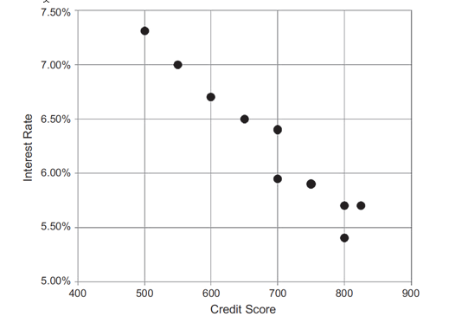
Data Exploration
Data preparation starts with an in-depth exploration of the data and understanding the dataset better. Data exploration, also known as exploratory data analysis(EDA), provides simple tools to understand the data fully. Exploratory Data Analysis (EDA) is the process of analyzing and visualizing data to understand its structure, identify patterns, detect outliers, and gather insights before applying machine learning models .Data exploration approaches involve computing descriptive statistics and visualization of data.

Slide 22
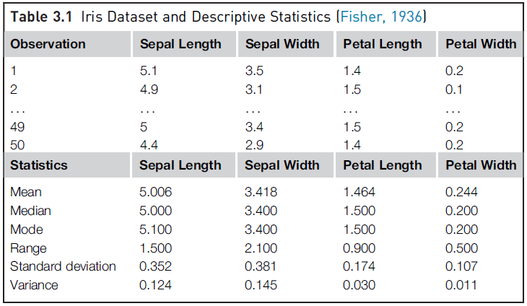
Data Exploration

Slide 23
Data Quality
Data quality is the measure of how well suited a data set is to serve its specific purpose. Measures of data quality are based Data Correctness, Data Freshness and Data Completeness.
Data Correctness: How accurately the data value describes real-world facts. In other words, data correctness ensures that each data point is both accurate and reliable, meaning it reflects the truth as closely as possible. Data is accurate when it represents real-world values without error. For example, if a customer’s age is listed as 29 in a database, data accuracy would mean that this number actually reflects the customer's real age.. There are many potential root causes of collection issues such as collection noise, faulty data transformations, outdated data, or incorrect schema description.

Slide 24
Why Data Correctness is Important ?
Data correctness is critical because incorrect data can lead to poor decisions, unreliable results, and even damage to an organization’s credibility.
For example: In healthcare, incorrect patient data could lead to inappropriate treatment.

Slide 25
Data Freshness : This refers to how relevant the data is to describe the current state of an entity, and takes into consideration the timeliness of the data and how frequently it is updated. Data is correct when it is also up-to-date. Real-world values change over time, so data representing those values must be updated accordingly.
Example: A customer’s address may change, and a database would need to reflect that change promptly to stay accurate.

Slide 26
Data Completeness: Data completeness refers to whether all necessary values are present in the dataset. For instance, if a dataset tracks employees, each employee entry should have essential information like name, ID, position, etc. Missing data can lead to an incomplete view of reality, which affects the correctness of the entire dataset.

Slide 27
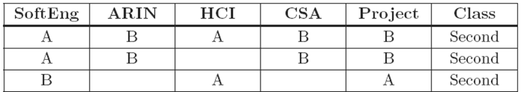
Missing Values
In many real-world datasets data values are not recorded for all attributes. This can happen simply because there are some attributes that are not applicable for some instances, a malfunction of the equipment used to record the data, a data collection form to which additional fields were added after some data had been collected, information that could not be obtained, e.g. about a hospital patient
k-nearest neighbor (k-NN) algorithm for classification tasks are often robust with missing values. Neural network models for classification tasks do not perform well with missing attributes, and thus, the data preparation step is essential for developing neural network models

Slide 28
Methods to Handle Missing Values
Discard Instances
Replace by Most Frequent/Average Value

Slide 29
Discard Instances
This is the simplest strategy: delete all instances where there is at least one missing value and use the remainder.
It has the advantage of avoiding introducing any data errors. Its disadvantage is that discarding data may damage the reliability of the results derived from the data

Slide 30
Replace by Most Frequent/Average Value
A less cautious strategy is to estimate each of the missing values using the values that are present in the dataset.
A straightforward but effective way of doing this for a categorical attribute is to use its most frequently occurring (non-missing) value
In the case of continuous attributes, it is likely that no specific numerical value will occur more than a small number of times. In this case the estimate used is generally the average value.

Slide 31
Noisy Values
A noisy value to mean one that is valid for the dataset, but is incorrectly recorded
The number 69.72 may accidentally be entered as 6.972, or a categorical attribute value such as brown may accidentally be recorded as another of the possible values, such as blue.

Slide 32
Invalid Values
69.7X for 6.972 or bbrown for brown
An invalid value can easily be detected and either corrected or rejected

Slide 33
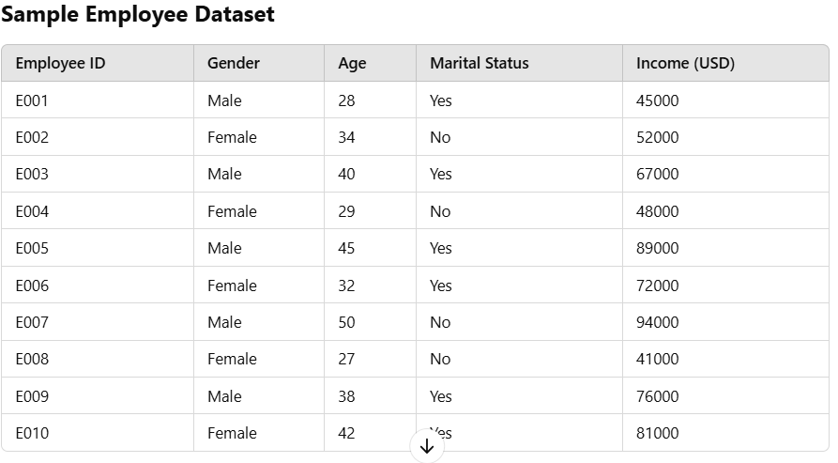
Data types and Conversion
The attributes in a dataset can be of different types, such as continuous numeric (interest rate), integer numeric (credit score), or categorical. For example, the credit score can be expressed as categorical values (poor, good, excellent) or numeric score. Different data science algorithms impose different restrictions on the attribute data types.

Slide 34
Transformation
In some data science algorithms like k-NN, the input attributes are expected to be numeric and normalized, because the algorithm compares the values of different attributes and calculates distance between the data points. Normalization prevents one attribute dominating the distance results because of large values. To overcome this problem ,we generally normalize the values of continuous attributes.
The idea is to make the values of each attribute run from 0 to 1. In general, if the lowest value of attribute A is min and the highest value is max, we convert each value of A, say a, to (a − min)/(max − min).

Slide 35
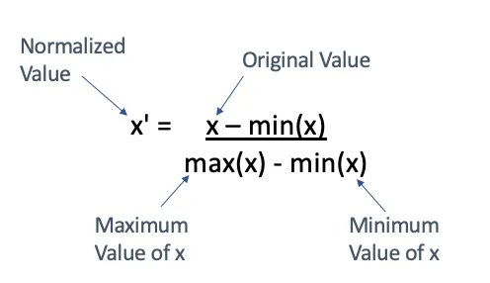
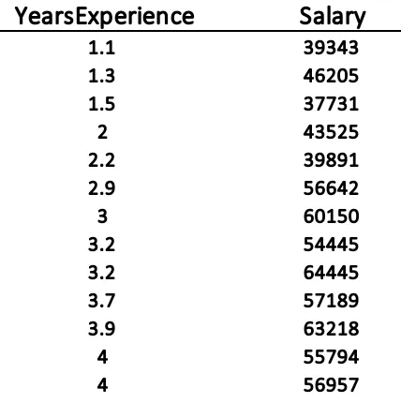
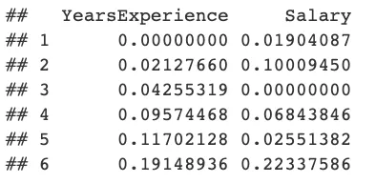
Transformation
First 13 rows of the salary data
First 6 rows of Normalized data (Min-Max Normalization)
Notes:
https://medium.com/swlh/data-normalisation-with-r-6ef1d1947970

Slide 36
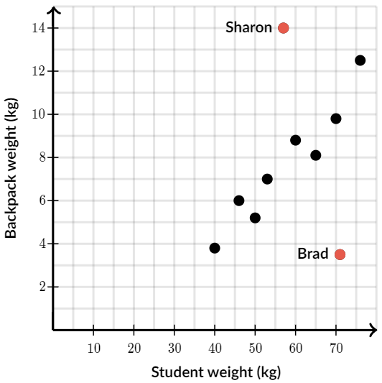
Outliers
Outliers are those data points that are significantly different from the rest of the dataset. They are often abnormal observations that skew the data distribution, and arise due to inconsistent data entry, or erroneous observations. Detecting outliers may be the primary purpose of some data science applications, like fake email detection, fraud or intrusion detection.

Slide 37
Feature Selection
Reducing the number of attributes, without significant loss in the performance of the model, is called feature selection.
many data science problems involve a dataset with hundreds to thousands of attributes. In text mining applications, every distinct word in a document forms a distinct attribute in the dataset. Not all the attributes are equally important or useful in predicting the target. The presence of some attributes might be counter productive. Some of the attributes may be highly correlated with each other, like annual income and taxes paid. A large number of attributes in the dataset significantly increases the complexity of a model and may degrade the performance of the model due to the curse of dimensionality

Slide 38
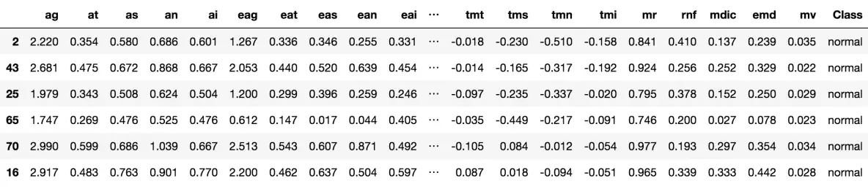
Feature Selection
Glaucoma Dataset (62 features)
Notes:
https://www.machinelearningplus.com/machine-learning/feature-selection/

Slide 39
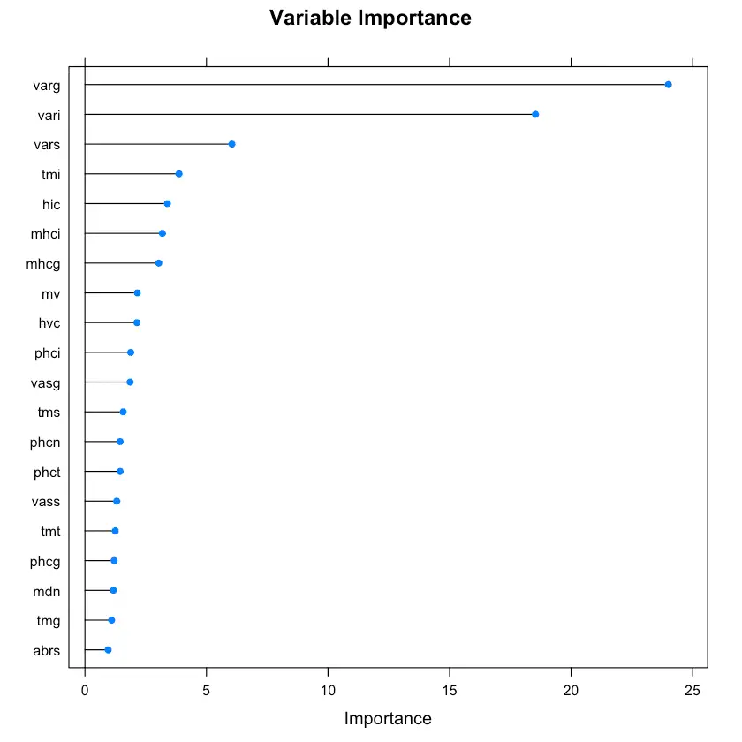
Feature Selection
Glaucoma Dataset (62 features)
Regularized Random Forest – Variable Importance
Notes:
https://www.machinelearningplus.com/machine-learning/feature-selection/

Slide 40
Data Sampling
Sampling is a process of selecting a subset of records as a representation of the original dataset for use in data analysis or modeling. The sample data serve as a representative of the original dataset with similar properties, such as a similar mean. Sampling reduces the amount of data that need to be processed and speeds up the build process of the modeling. In most cases, to gain insights, extract the information, and to build representative predictive models it is sufficient to work with samples. Theoretically, the error introduced by sampling impacts the relevancy of the model, but their benefits far outweigh the risks.

Slide 41
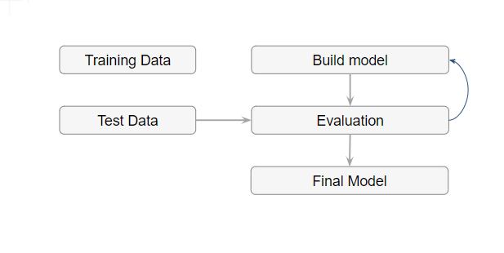
MODELING
A model is the abstract representation of the data and the relationships in a given dataset.

Slide 42
MODELING
Splitting Training and Test data sets: The modeling step creates a representative model inferred from the data. The dataset used to create the model, with known attributes and target, is called the training dataset.
The validity of the created model will also need to be checked with another known dataset called the test dataset or validation dataset. To facilitate this process, the overall known dataset can be split into a training dataset and a test dataset. A standard rule of thumb is two-thirds of the data are to be used as training and one-third as a test dataset

Slide 43
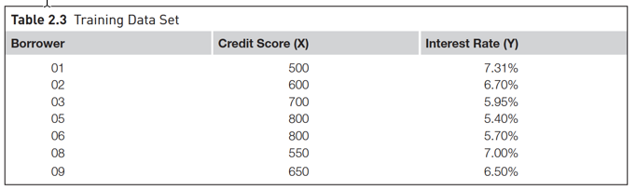
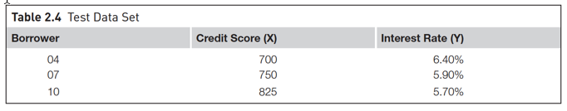
Training Set and Test Set

Slide 44
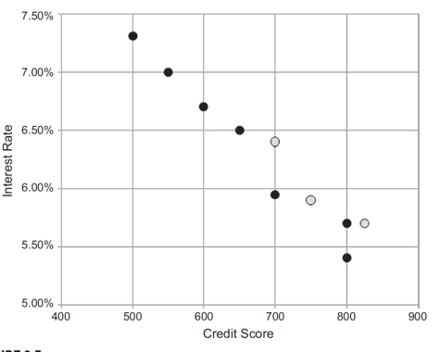

MODELING
Splitting Training and Test data sets

Slide 45
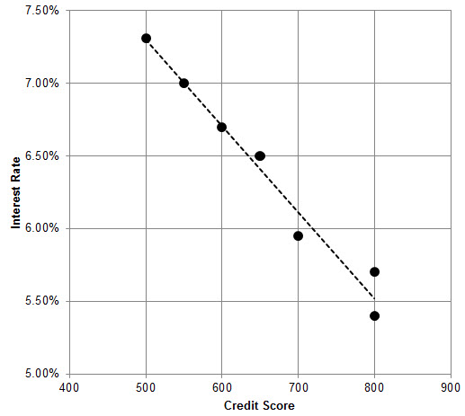
MODELING

Slide 46
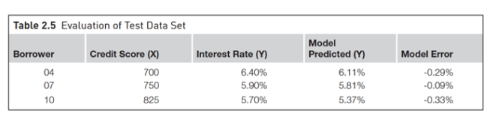
MODELING
Evaluation of test dataset

Slide 47
Application
Product readiness
Technical integration
Model response time
Remodeling
Assimilation

Slide 48
Knowledge
Posterior knowledge

